Slide 1
ns-3 setup and Traffic Model
& System Architecture
Assignment 2:
Name : Rahmat Munir Hasan (M11302828)
Reference :
Chatgpt

Slide 2
1. ns-3 setup and install
$ git clone https://gitlab.com/nsnam/ns-3-dev.git
$ cd ns-3-dev
$ git checkout -b ns-3.45-branch ns-3.45
$ ./ns3 configure --enable-examples --enable-tests
$ ./ns3 build
$ sudo apt update
$ sudo apt install wireshark
$ sudo usermod -aG wireshark $USER

Slide 3
$ ./ns3 run "scratch/traffic-gaussian \
--packets=1000 \
--payloadBytes=512 \
--meanIat=0.030 \
--stdIat=0.010 \
--minIat=0.005 \
--maxIat=0.080 \
--simStop=45 \
--prefix=traffic“
$ python3 analysis/analyze_interarrival.py \
--pcap traffic-0-0.pcap \
--out results
$ python3 analysis/packet_size_density_pdf_cdf.py \
--pcap traffic-0-0.pcap \
--out results2 \
--kde

Slide 4
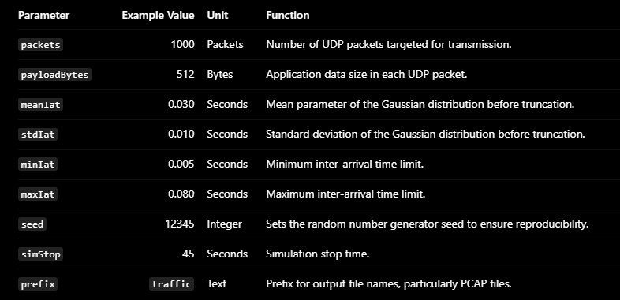
2. Traffic Model

Slide 5
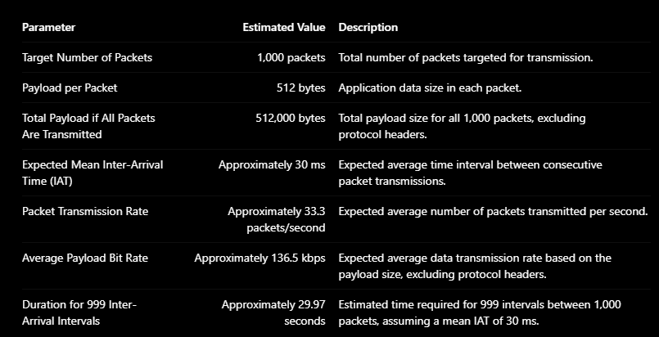

Slide 6
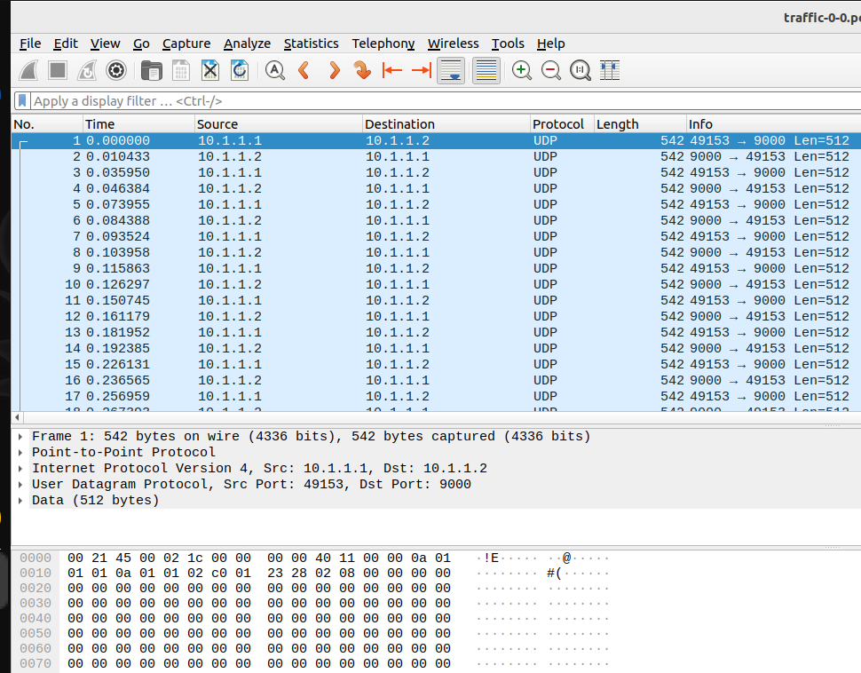
3. Wireshark Simulation

Slide 7
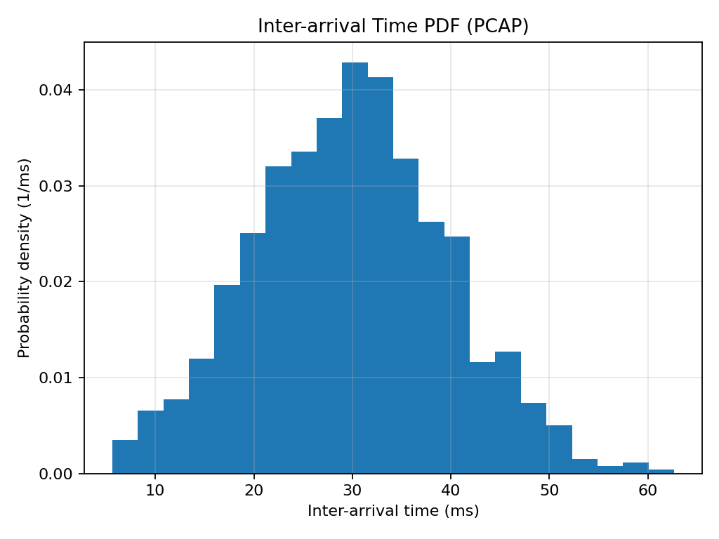
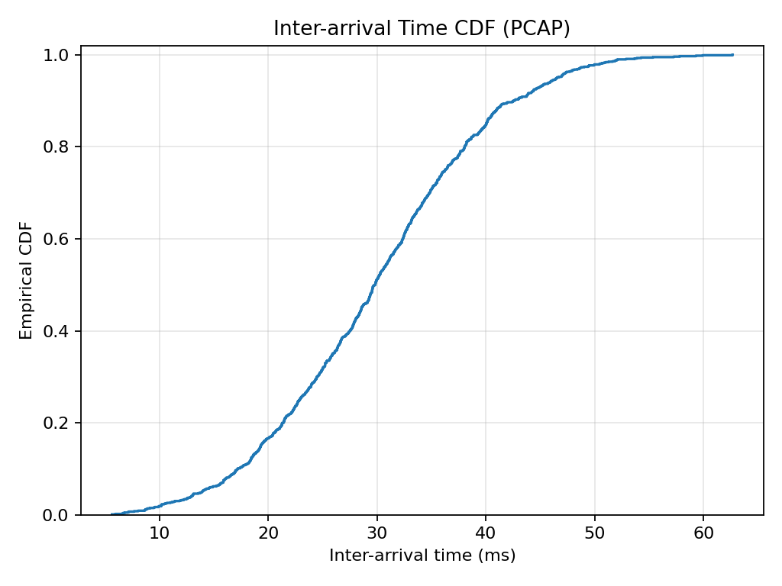
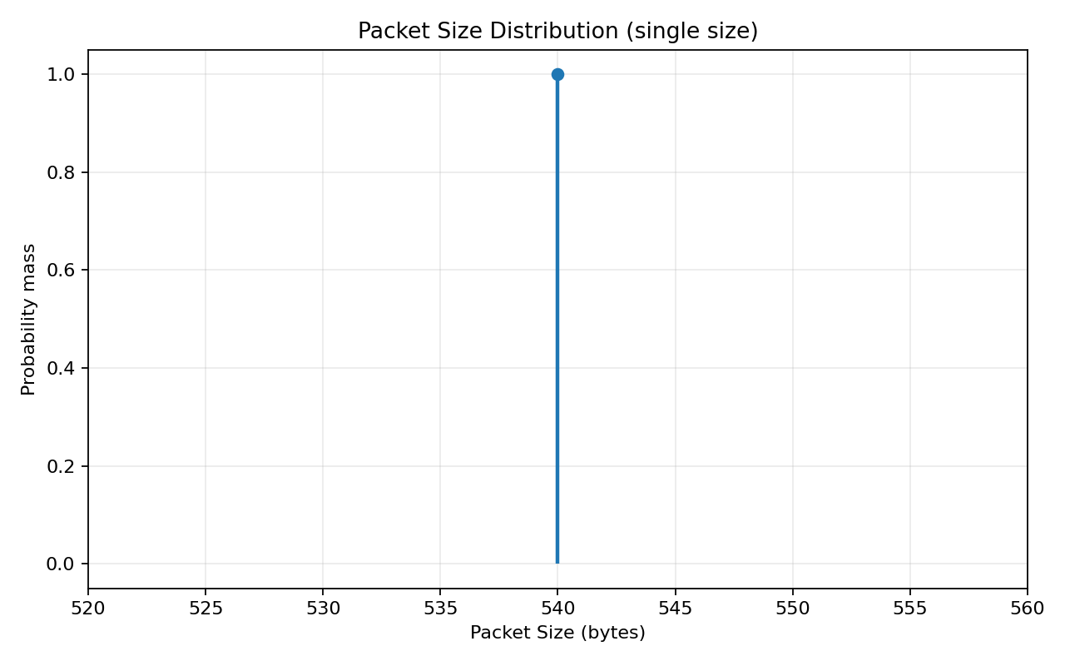
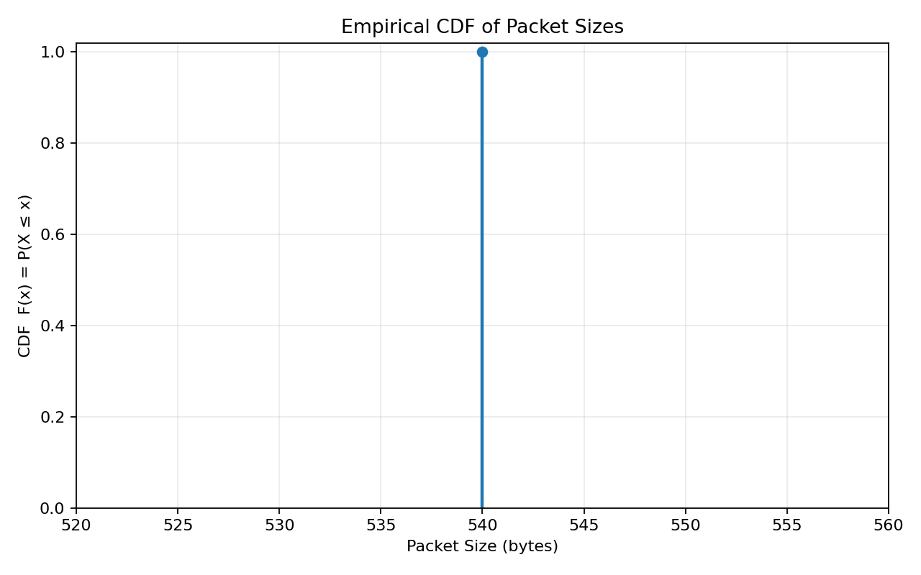
4. Result
From 4 graph the simulation demonstrates two different traffic characteristics:
Inter-arrival time (IAT): Varies and exhibits a pattern resembling a Gaussian distribution.
Packet size: Remains constant at 540 bytes, resulting in a distribution concentrated at a single value.
Overall, these graphs indicate that the traffic generator successfully produces variations in packet arrival times while maintaining a fixed packet size.

Slide 8





CDF Iat CALCULATION
We will use sample packet data from the ns-3 simulation to manually calculate the CDF,
then relate it to the CDF graph you generated earlier..
1. We know from the data 1 packet in 0 ms arrival time, 2 packet in 20 ms, 3 packet in 45 ms …… 11 packet
1
2
4
3
2. Calculate interval time to get inter-arrival time : then :
3. Take 11 packet sample to generate cdf graphs manual: packet 2 have 20 ms, packet 3 have 25ms ….. Packet 11 = 35 ms
4. Packet 1 → packet 11, have Sort the IAT scores from smallest to largest: 20 ms , 20 ms, 25 ms, 25 ms, 30 ms , 30 ms, 30 ms, 35 ms, 35 ms, 40 ms
5. Numbers of sample (n) = 10.

Slide 9
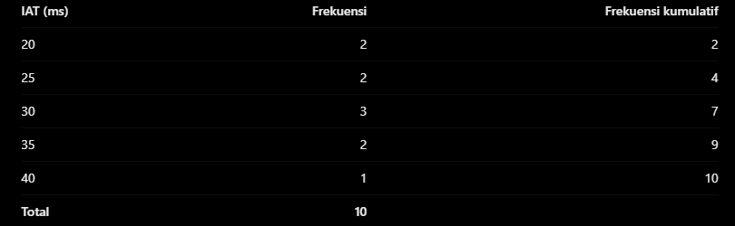




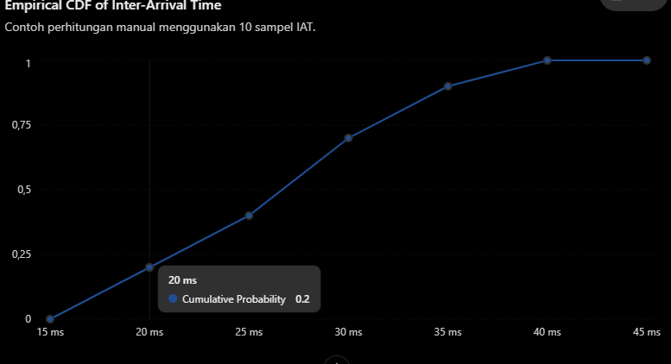
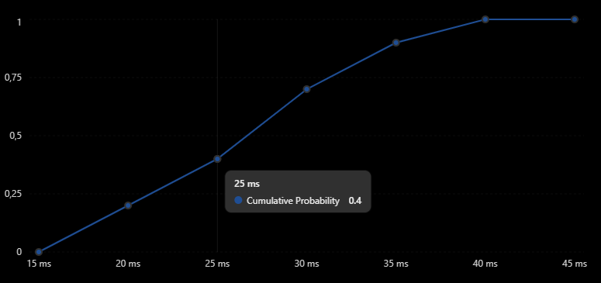
6. Calculate CDF with manually
……

Slide 10
CDF with inter-arrival time Analysis
A. Interpretation of the axes
X-axis: Inter-arrival time in milliseconds (ms).
Y-axis: Cumulative probability, ranging from 0 to 1.
B. Statistical interpretation
The CDF exhibits an S-shaped curve, with its steepest increase occurring approximately between 25 and 35 ms.
This indicates that:
Most packets have inter-arrival times close to 30 ms.
Approximately 50% of the inter-arrival times are less than or equal to 30 ms.
Approximately 90% of the inter-arrival times are less than or equal to 43 ms.
Only a small proportion of intervals exceed 50 ms.
This shape is consistent with a probability distribution concentrated around its central value.

Slide 11

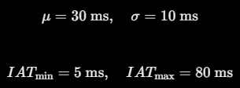
Pdf Iat CALCULATION & Analysis
A. Interpretasi sumbu
Sumbu X: inter-arrival time (ms).
Sumbu Y: probability density (1/ms).
The histogram shows a single dominant peak near 30 ms, followed by decreasing probability density toward shorter and longer inter-arrival times.
B. Relationship with the truncated Gaussian distribution
The previous traffic generator configuration used the following parameters:
The graph shows a peak near 30 ms, which is consistent with the expected center of the distribution. The observed inter-arrival times extend only to approximately 63 ms, even though the configured maximum is 80 ms.

Slide 12


CDF with packet size & Analysis
The graph indicates that:
This means that 100% of the analyzed packets have a size of 540 bytes.
The empirical CDF can therefore be expressed as:
In other words:
For packet sizes smaller than 540 bytes, the cumulative probability is 0.
At 540 bytes, the cumulative probability immediately increases to 1.
For packet sizes greater than 540 bytes, the cumulative probability remains 1.
Interpretation of the results :
The packet size CDF is mathematically correct if every analyzed packet has the same size. However, the graph does not demonstrate packet size variability. Therefore, the result is insufficient for evaluating a variable packet size distribution, such as those used in certain XR traffic models.

Slide 13
PDF with packet size & Analysis
The fourth graph illustrates the packet size distribution using a single
vertical line at 540 bytes.
A. Interpretation of the axes
X-axis: Packet size (bytes).
Y-axis: Probability mass.
Unlike a continuous PDF histogram, this graph represents probability mass
concentrated at one specific packet size.

Slide 14
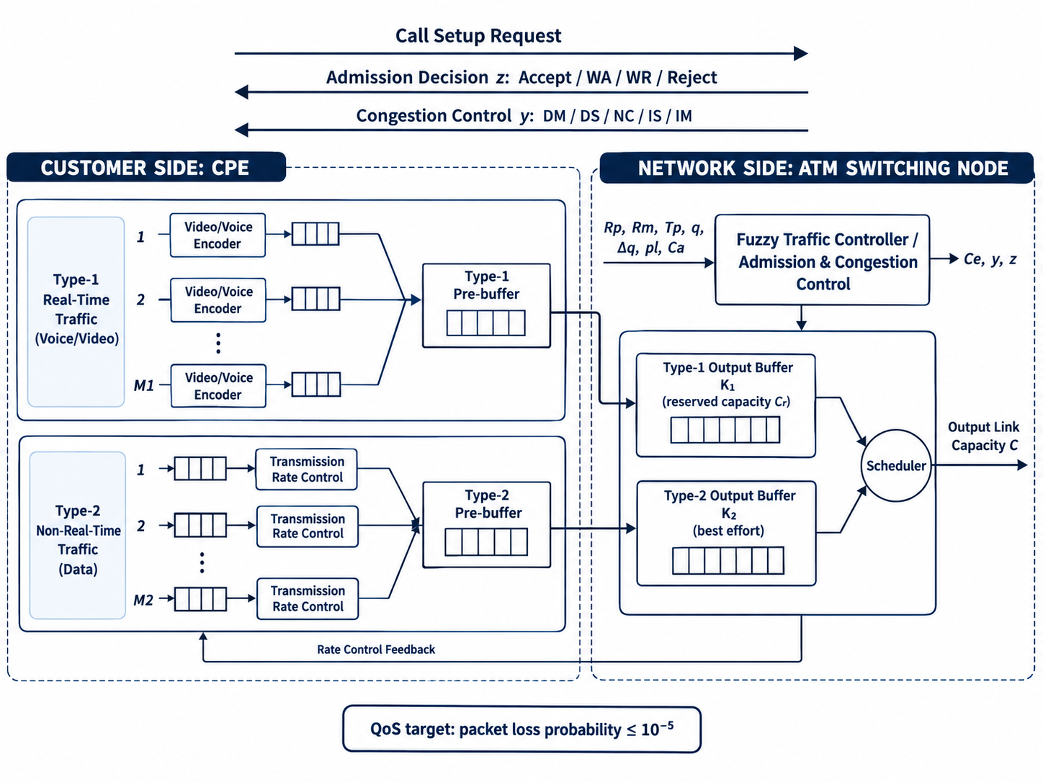
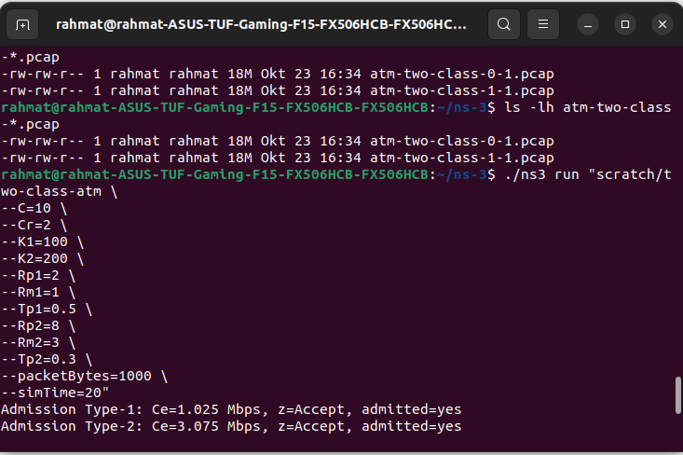
System architecture

